Slide 1
ATAI
Advanced Technique of Artificial Intelligence
ATAI
ChongqingUniversity _{AdvancedTechniqueof}
of Technology Artificial Intelligence
Chongqing University of
Technology
Chongqing University ^{ATAI}
_{of Technology} Advanced Techniqueof
Artificial Intelligence
Chongqing University of Technology
Chongqing University of Technology
Graph Coarsening via Supervised Granular-Ball for Scalable Graph Neural Network Training
Code : https://github.com/mxjun17/Granular-Ball-NodeClassifction.
—— AAAI2025
Reported by Jing Li
1

Slide 2
ATAI
Advanced Technique of Artificial Intelligence
ATAI
ChongqingUniversity _{AdvancedTechniqueof}
of Technology Artificial Intelligence
Chongqing University of
Technology
Chongqing University ^{ATAI}
_{of Technology} Advanced Techniqueof
Artificial Intelligence
Chongqing University of Technology
Chongqing University of Technology
Introduction
1、Graph Neural Networks (GNNs) have demonstrated significant achievements in processing graph data, yet scalability remains a substantial challenge.To address this, numerous graph coarsening methods have been developed. However,most existing coarsening methods are training-dependent,leading to lower efficiency. In this paper, we employ granular-ball computing to effectively compress graph data.

Slide 3
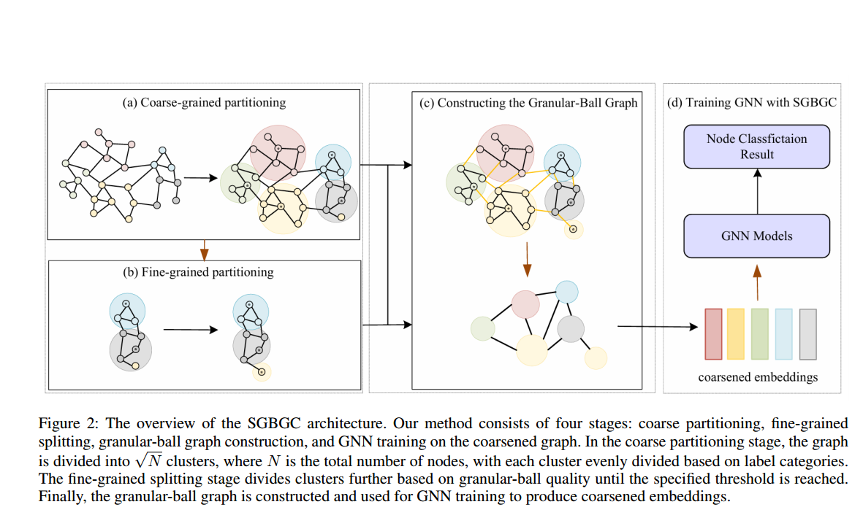
ATAI
Advanced Technique of Artificial Intelligence
ATAI
ChongqingUniversity _{AdvancedTechniqueof}
of Technology Artificial Intelligence
Chongqing University of
Technology
Chongqing University ^{ATAI}
_{of Technology} Advanced Techniqueof
Artificial Intelligence
Chongqing University of Technology
Chongqing University of Technology
Overview

Slide 4
ATAI
Advanced Technique of Artificial Intelligence
ATAI
ChongqingUniversity _{AdvancedTechniqueof}
of Technology Artificial Intelligence
Chongqing University of
Technology
Chongqing University ^{ATAI}
_{of Technology} Advanced Techniqueof
Artificial Intelligence
Chongqing University of Technology
Chongqing University of Technology
Method

Slide 5
ATAI
Advanced Technique of Artificial Intelligence
ATAI
ChongqingUniversity _{AdvancedTechniqueof}
of Technology Artificial Intelligence
Chongqing University of
Technology
Chongqing University ^{ATAI}
_{of Technology} Advanced Techniqueof
Artificial Intelligence
Chongqing University of Technology
Chongqing University of Technology
Method

Slide 6
ATAI
Advanced Technique of Artificial Intelligence
ATAI
ChongqingUniversity _{AdvancedTechniqueof}
of Technology Artificial Intelligence
Chongqing University of
Technology
Chongqing University ^{ATAI}
_{of Technology} Advanced Techniqueof
Artificial Intelligence
Chongqing University of Technology
Chongqing University of Technology
Method

Slide 7
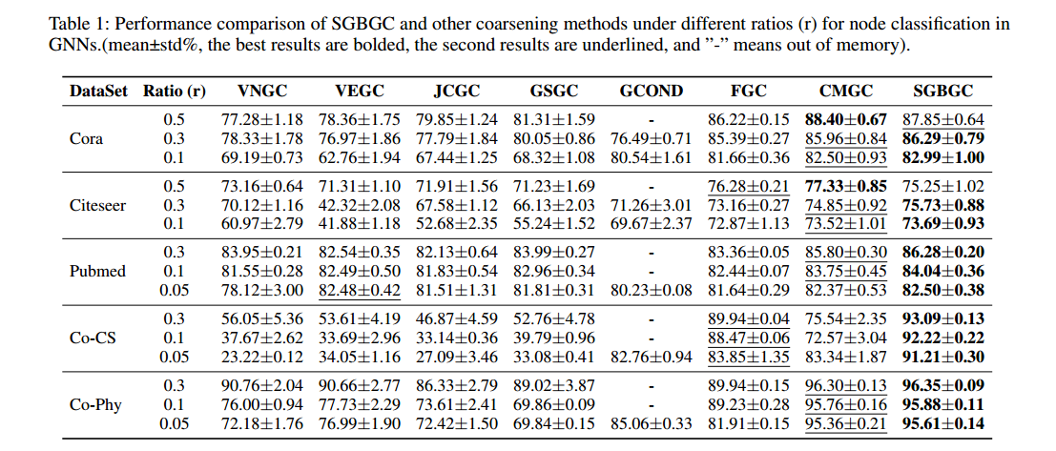
ATAI
Advanced Technique of Artificial Intelligence
ATAI
ChongqingUniversity _{AdvancedTechniqueof}
of Technology Artificial Intelligence
Chongqing University of
Technology
Chongqing University ^{ATAI}
_{of Technology} Advanced Techniqueof
Artificial Intelligence
Chongqing University of Technology
Chongqing University of Technology
Experiments

Slide 8
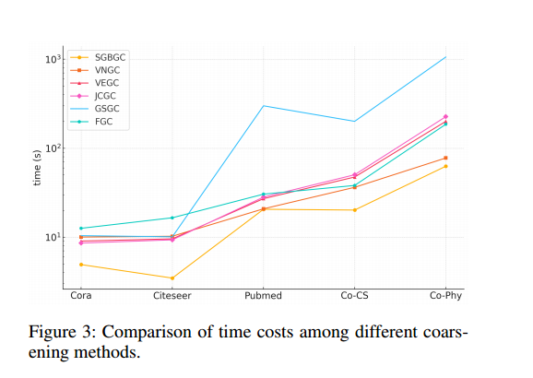
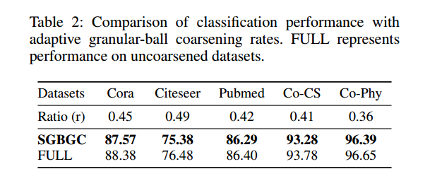
ATAI
Advanced Technique of Artificial Intelligence
ATAI
ChongqingUniversity _{AdvancedTechniqueof}
of Technology Artificial Intelligence
Chongqing University of
Technology
Chongqing University ^{ATAI}
_{of Technology} Advanced Techniqueof
Artificial Intelligence
Chongqing University of Technology
Chongqing University of Technology
Experiments

Slide 9
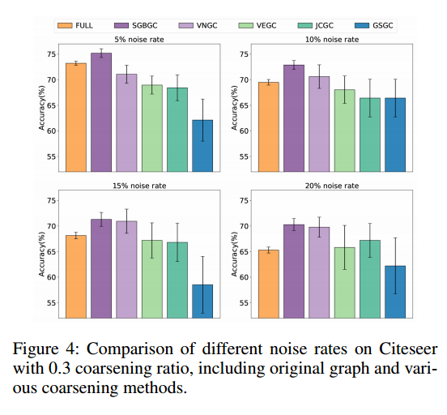
ATAI
Advanced Technique of Artificial Intelligence
ATAI
ChongqingUniversity _{AdvancedTechniqueof}
of Technology Artificial Intelligence
Chongqing University of
Technology
Chongqing University ^{ATAI}
_{of Technology} Advanced Techniqueof
Artificial Intelligence
Chongqing University of Technology
Chongqing University of Technology
Experiments

Slide 10
ATAI
Advanced Technique of Artificial Intelligence
ATAI
ChongqingUniversity _{AdvancedTechniqueof}
of Technology Artificial Intelligence
Chongqing University of
Technology
Chongqing University ^{ATAI}
_{of Technology} Advanced Techniqueof
Artificial Intelligence
Chongqing University of Technology
Chongqing University of Technology
Experiments

Slide 11
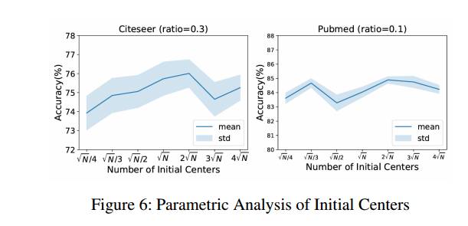
ATAI
Advanced Technique of Artificial Intelligence
ATAI
ChongqingUniversity _{AdvancedTechniqueof}
of Technology Artificial Intelligence
Chongqing University of
Technology
Chongqing University ^{ATAI}
_{of Technology} Advanced Techniqueof
Artificial Intelligence
Chongqing University of Technology
Chongqing University of Technology
Experiments

Slide 12
ATAI
Advanced Technique of Artificial Intelligence
ATAI
ChongqingUniversity _{AdvancedTechniqueof}
of Technology Artificial Intelligence
Chongqing University of
Technology
Chongqing University ^{ATAI}
_{of Technology} Advanced Techniqueof
Artificial Intelligence
Chongqing University of Technology
Chongqing University of Technology
Thanks!

